Slide 1
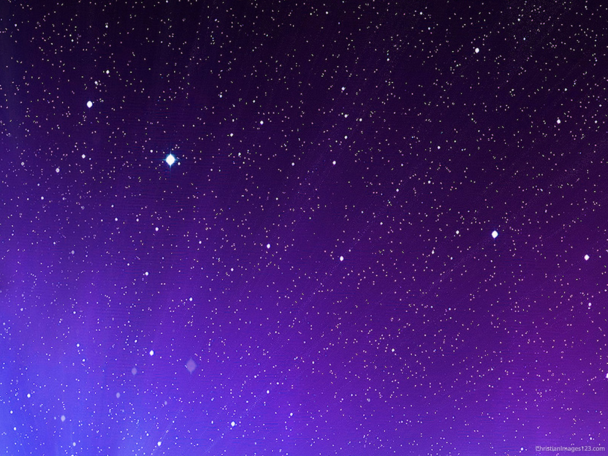
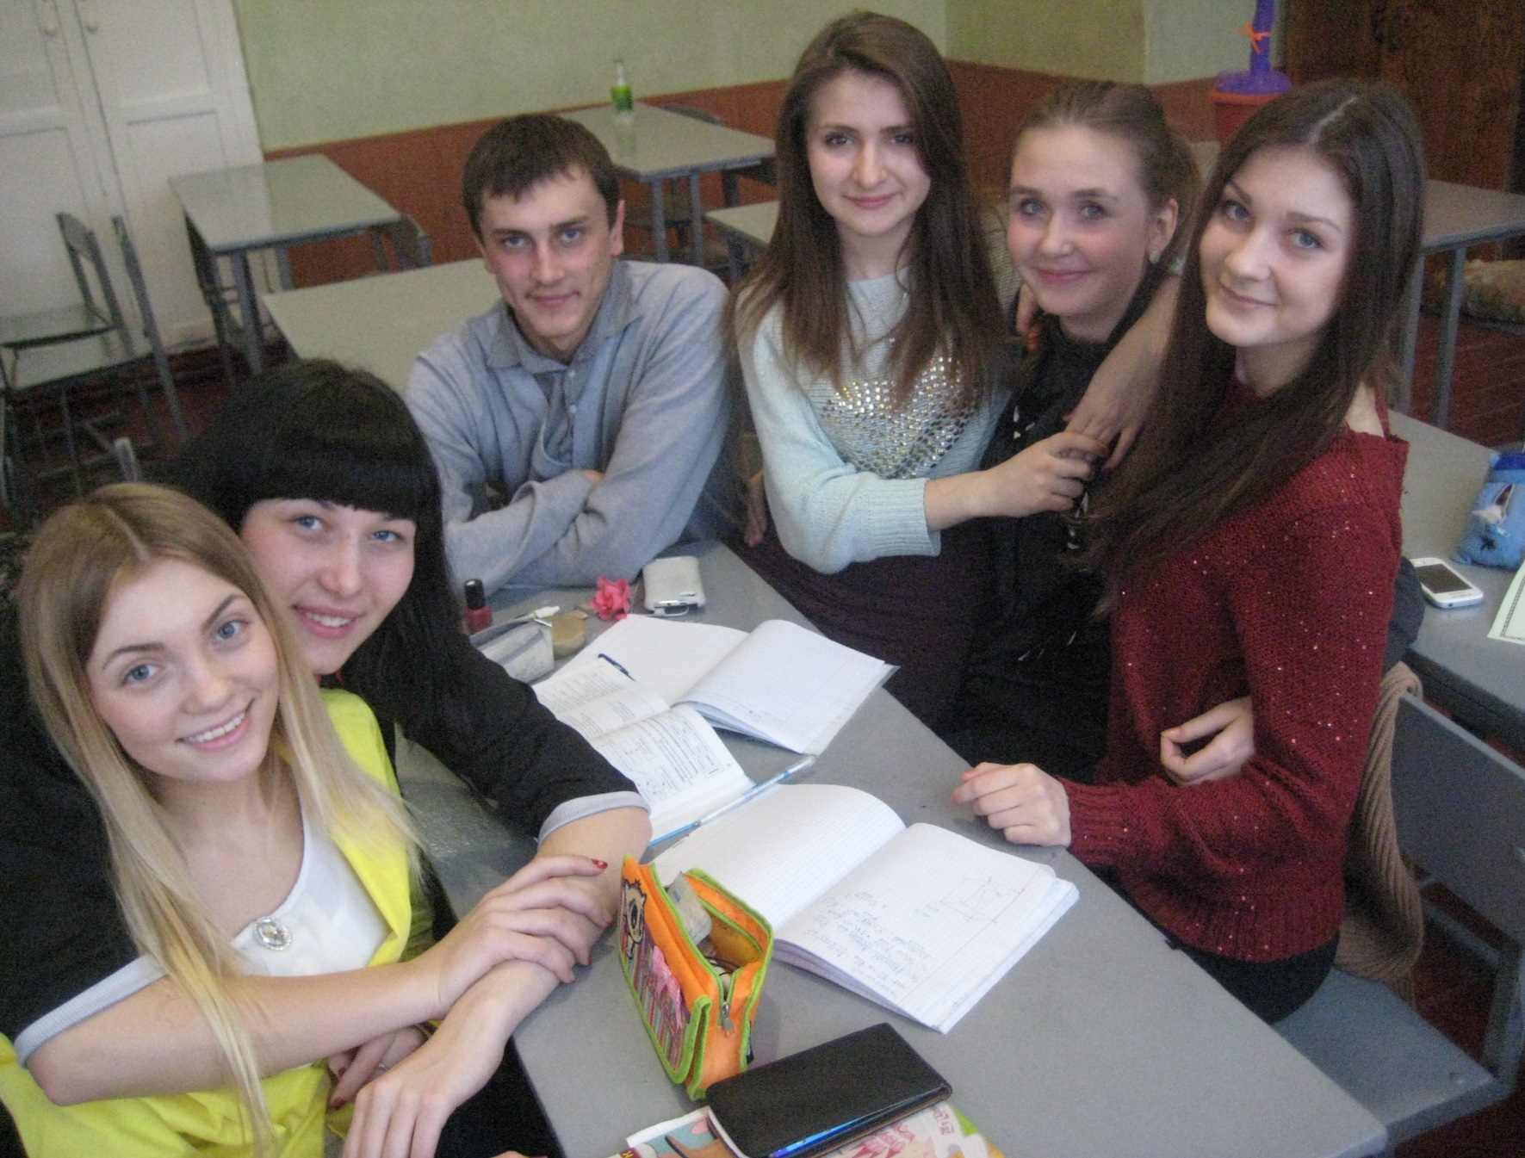
We used to be friends before…

Slide 2
When other parents found out that I am HIV-positive, I was forbidden to be friends with…

Slide 3
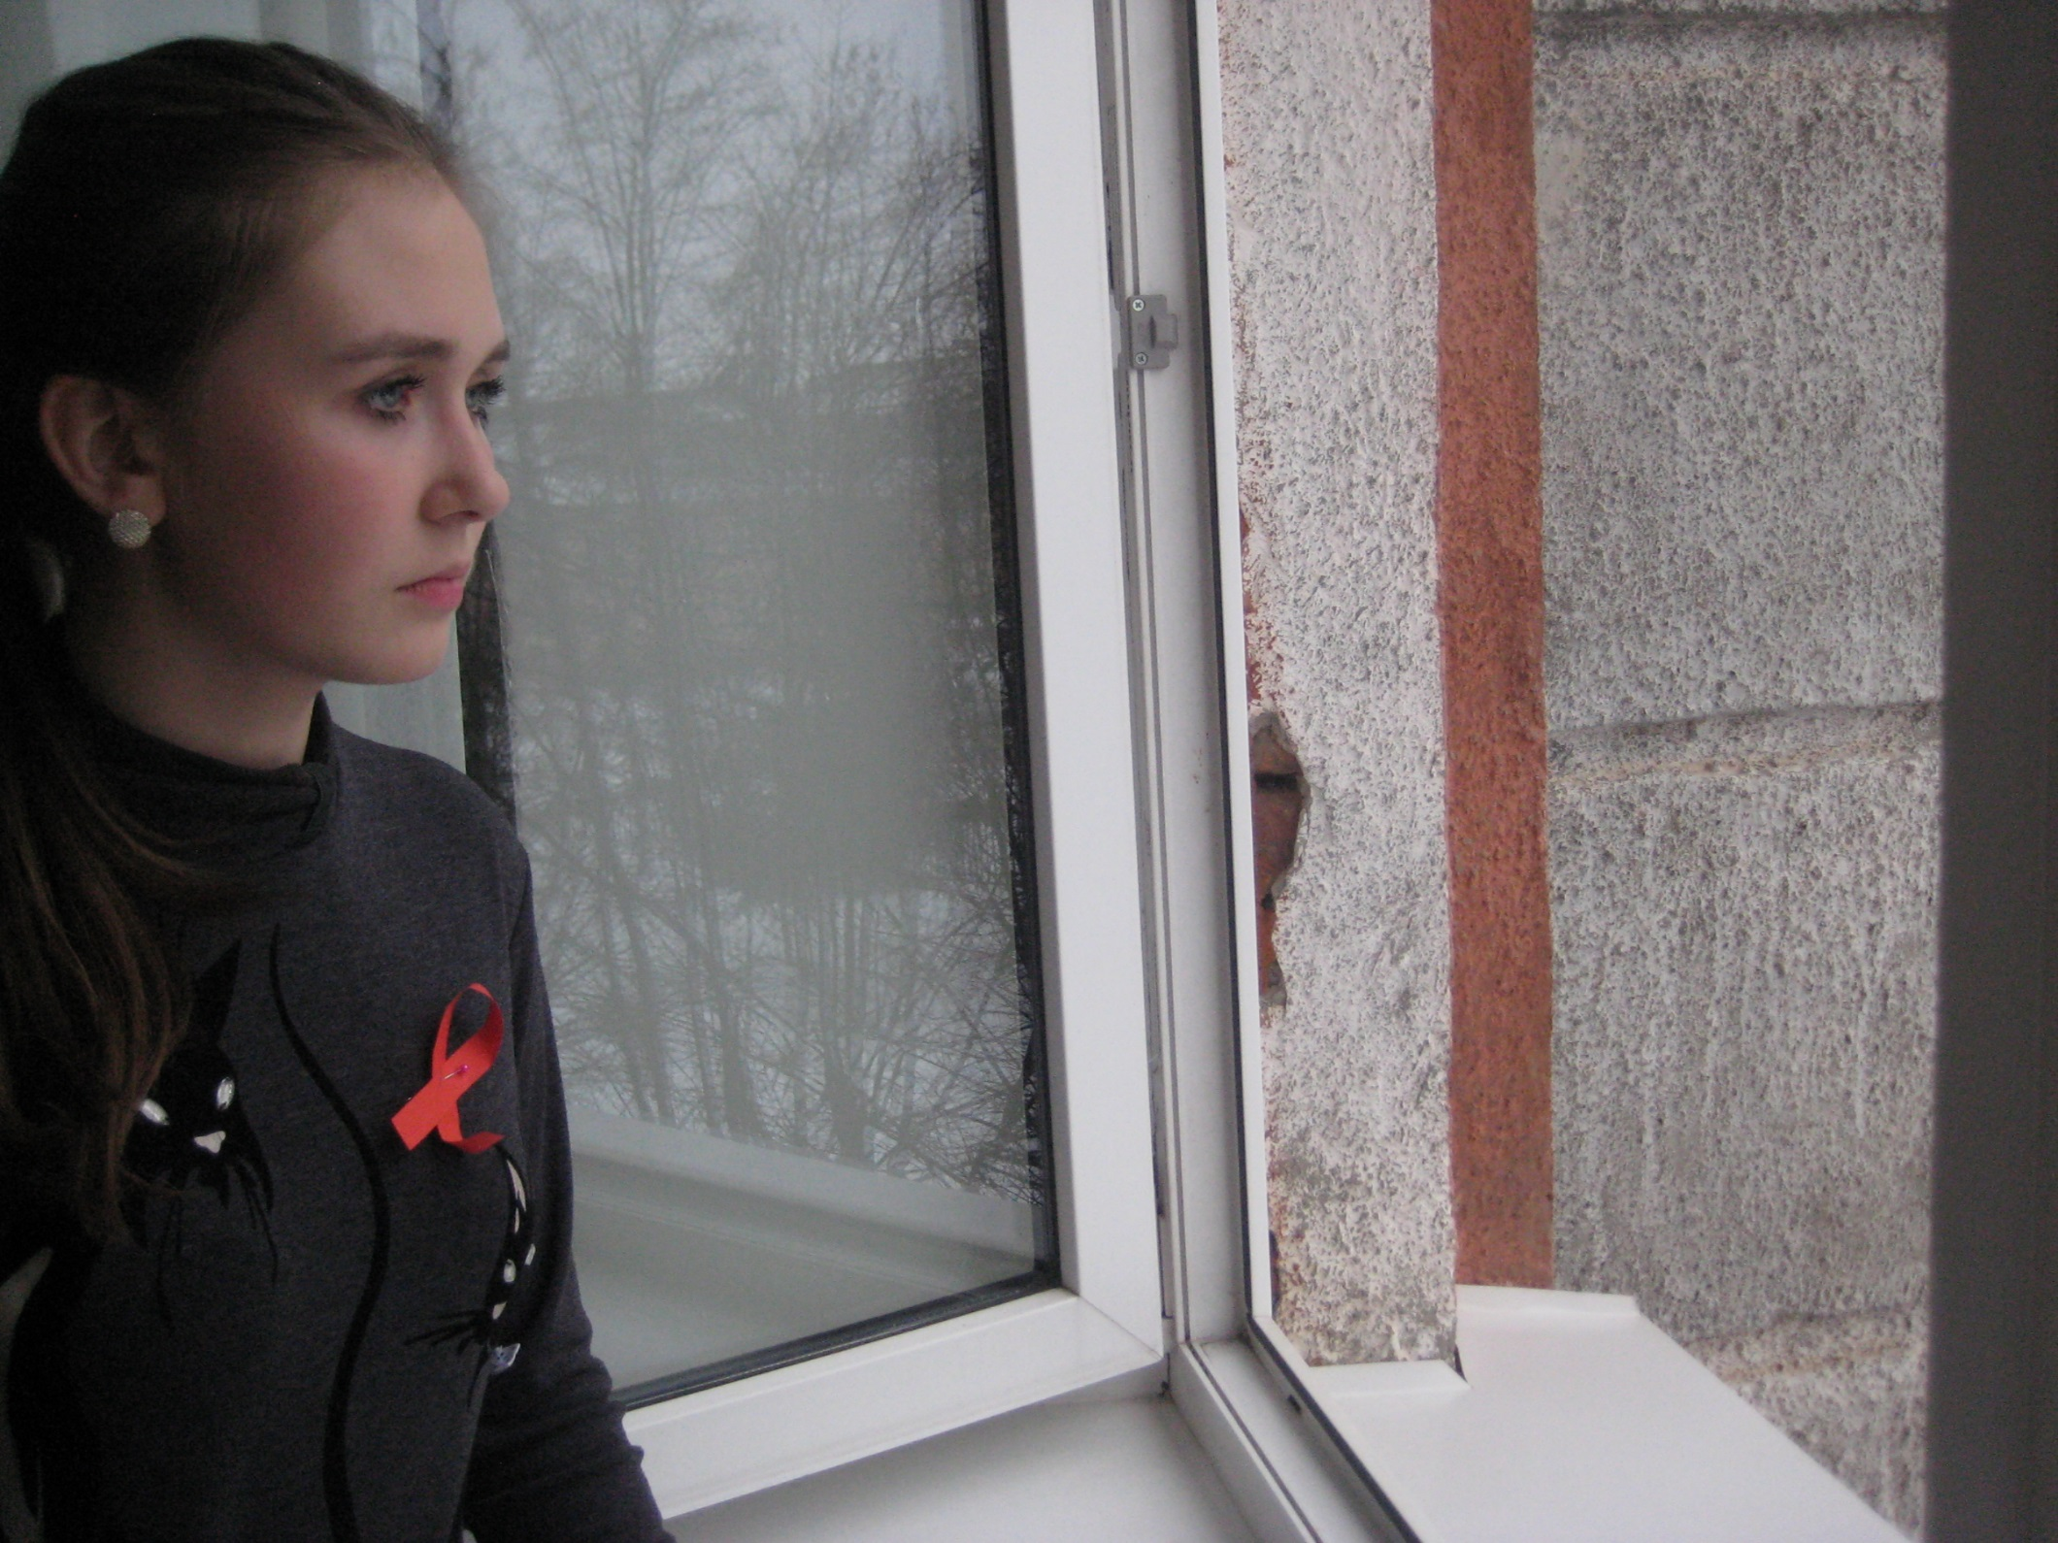
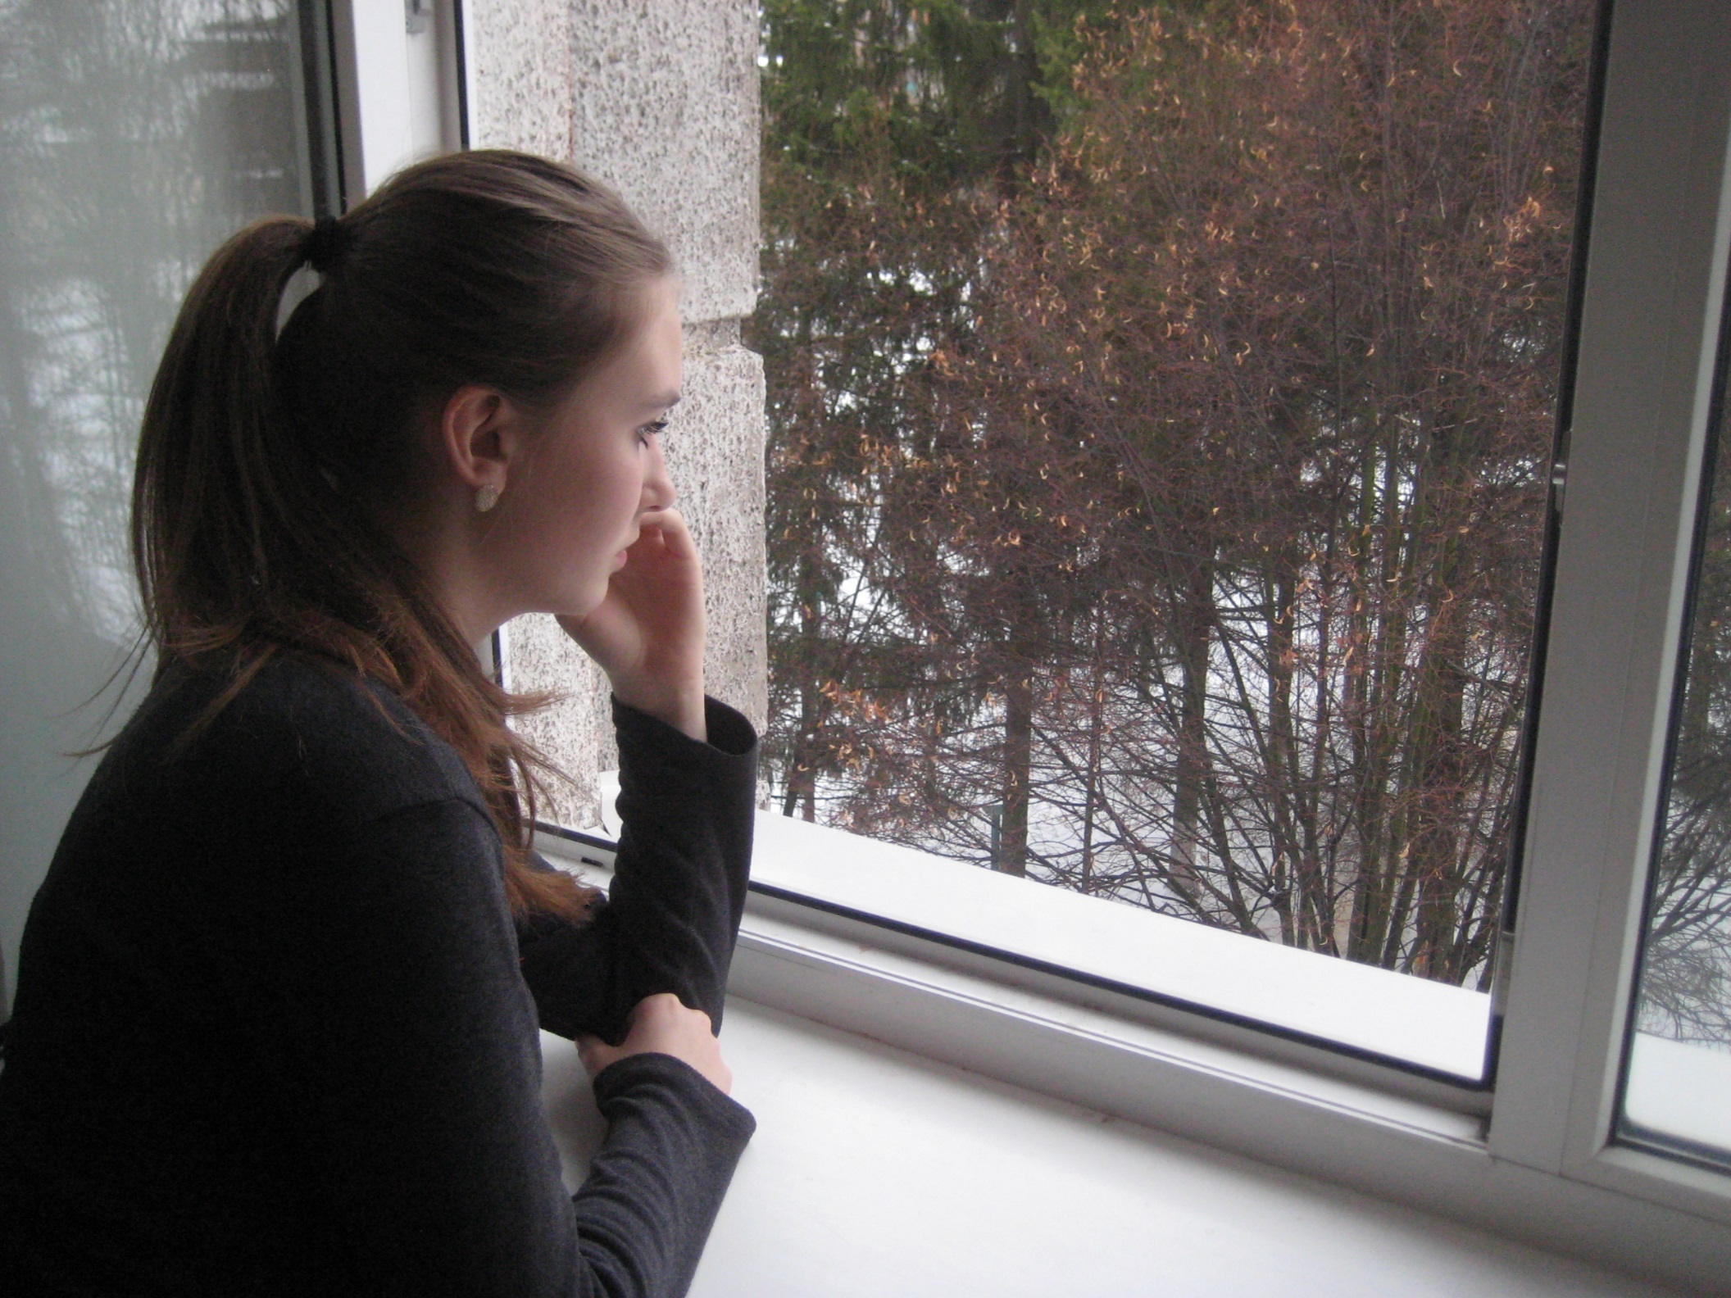
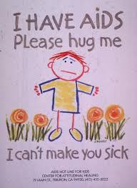
Fear…
loneliness…

Slide 4
When parents knew that it is not dangerous, we are together again !!

Slide 5
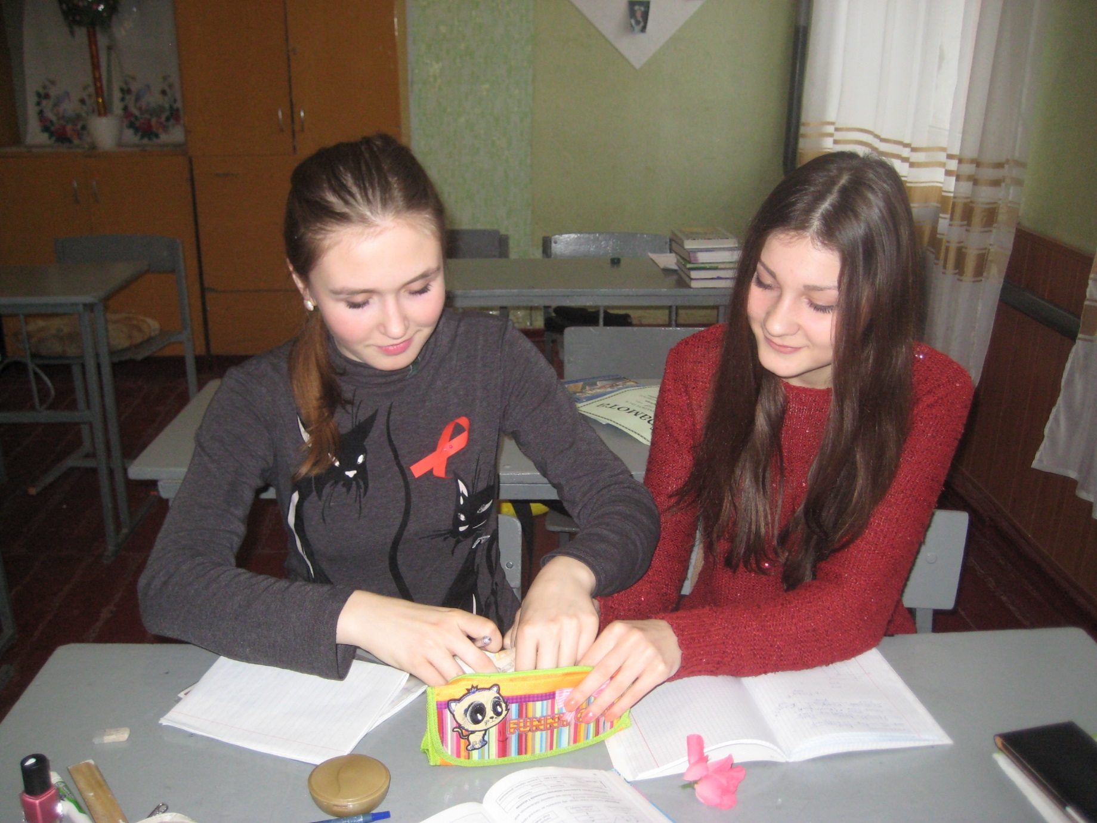
When parents knew that it is not dangerous, we are together again !!

Slide 6
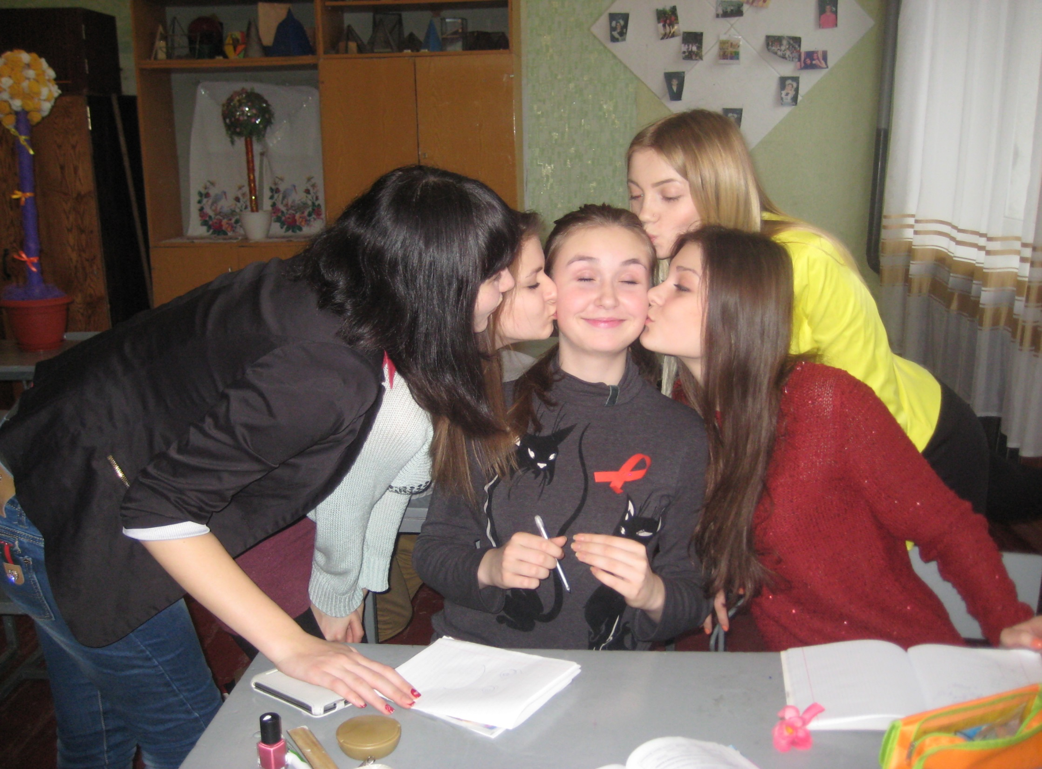

Slide 7
The children of HIV is not dangerous! they must have childhood too!!!

